Slide 1


Improving mathematics outcomes of Aboriginal & Torres Strait learners learners
AAMT Symposium for Remote Schools
12 September 2013
Australian Association of Mathematics Teachers Inc

Slide 2
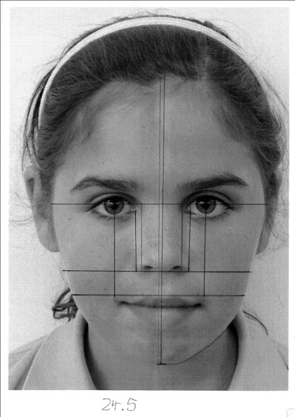
Imagine
Imagine if Aboriginal students in Australia had the same mathematics outcomes as non-Aboriginal students.
Australia would be a different place.

Slide 3

BLUEPRINT
Supporting best teaching of mathematics for Indigenous learners
A call for action
National Strategy
7

Slide 4
What are some of the best things happening in your classrooms, schools and communities?

Slide 5
Numeracy, mathematics and Indigenous learners

Slide 6
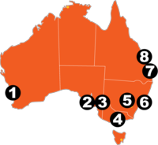



8. Gladstone
middle years investigative learning
7. Nerang
middle managers in mathematics
1. Swan
language of mathematics, Aboriginal educators & maths, teacher mentors
5. Orange
'8 Ways of Aboriginal learning'
2. Noarlunga
explicit and scaffolded pedagogy
6. Dharug
early years cultural identity through mathematics; meta-language
3. Alberton
Resilience; mathematisation & contexutalisaion
4. Healesville
cultural competency, 'front loading' students

Slide 7
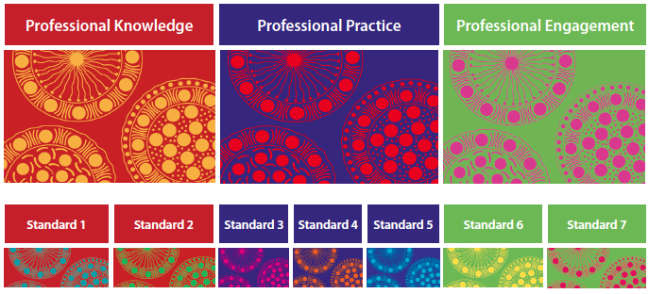
Cluster Findings
and associated resources
AITSL, 2011

Slide 8


Cluster Findings
and associated resources
Know Indigenous learners and know how they learn: Be aware, be connected, be sensitive
1.3 Know what is significant in the daily, lived reality of learners so mathematics learning can be culturally relevant and connected as well as academically rigorous.

Slide 9

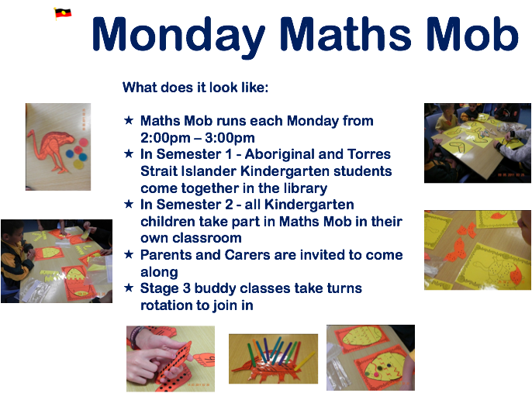

Slide 10
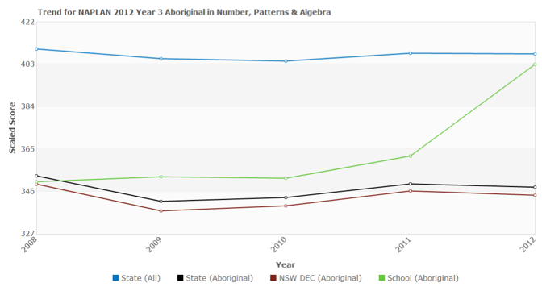
NAPLAN Data 2012

Slide 11
6 things we know from Make it count
cross-sectoral collaborations work
learning communities
  connected nationally, systemically and locally
  practitioner-researcher partnerships
  Focussed learning
  grass roots upwards
  PL in mathematics content knowledge, pedagogy and cultural responsiveness
Aboriginal educators play a key role
parent and family engagement and creating communities
leaders who are prepared to have a go
National approaches can work and work well.

Slide 12
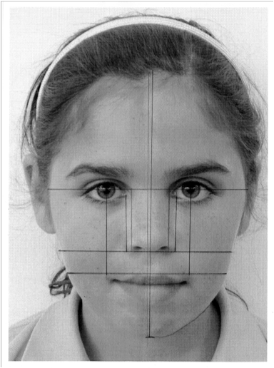

Better teaching of maths
Culturally responsive
Responsive mathematics pedagogy
Academically responsive
Socially responsive
Learning outcomes
Career/life opportunities

Slide 13
Coordinated & Connected
National Network
Strategic plan
Research agenda
partnerships

Slide 14
Your thoughts
What would be the key elements/foci of a strategic plan from remote schools/communities perspectives?

Slide 15
The Network
Next Steps
  Symposiums in each state & territory
  Initial meeting of the Network
    Planning group established
  Launch of Network in November
  National conference?
  …
8

